Slide 1
SUMMER SCHOOL OF TRUTH
2020
THE BIBLE
LESSONS #2 AND #3

Slide 2
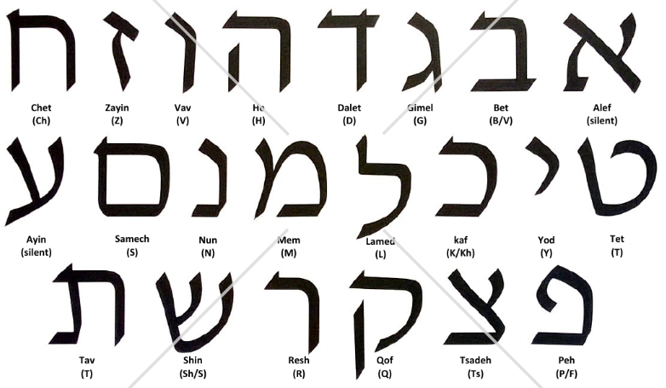
LANGUAGES USED IN THE BIBLE
1. HEBREW
22 Letters
All Consonants
Each has a Numerical Value
Vowel sounds are formed with additional symbols added to the Letters
Read from Right to Left

Slide 3
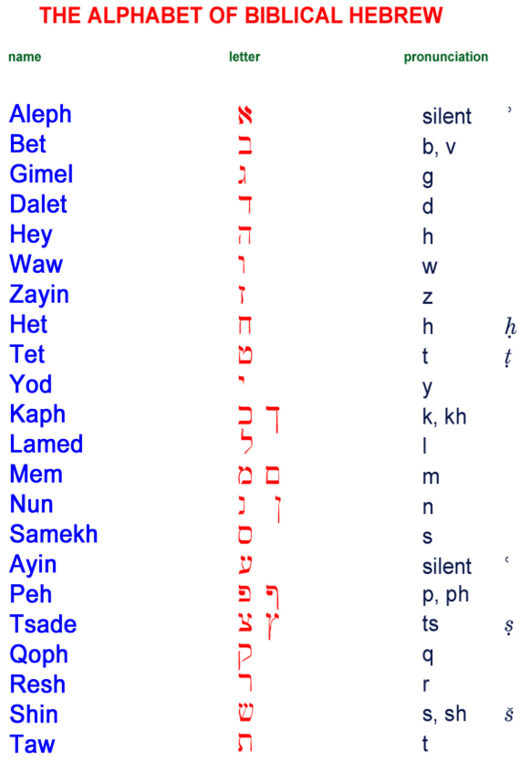
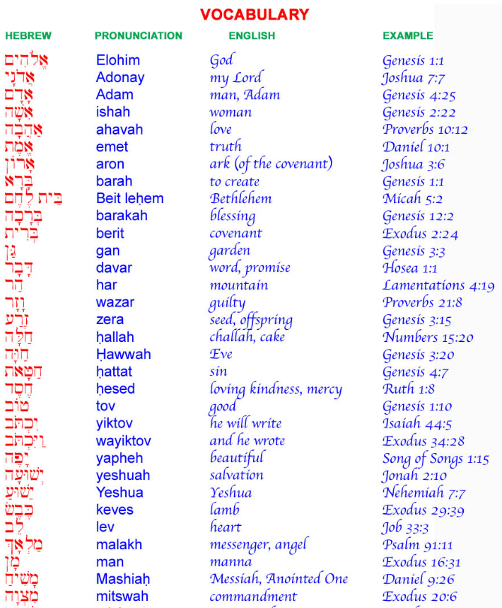
LANGUAGES USED IN THE BIBLE

Slide 4
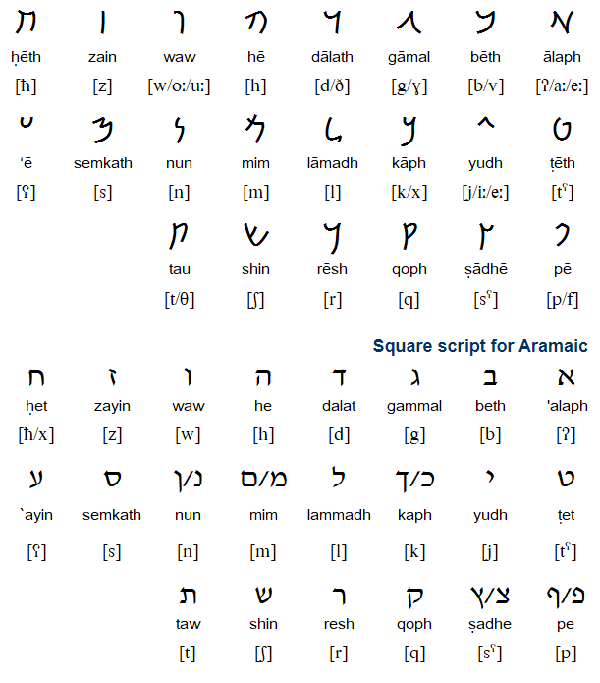
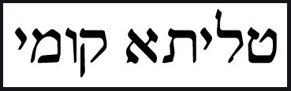
LANGUAGES USED IN THE BIBLE
2. ARAMAIC
Used 4 Times in the Old Testament
Example Use in the New Testament
Talitha Koum!
Talitha Koum! Which being interpreted is, Little girl, to you I say, Arise! – Mk. 5:41b

Slide 5
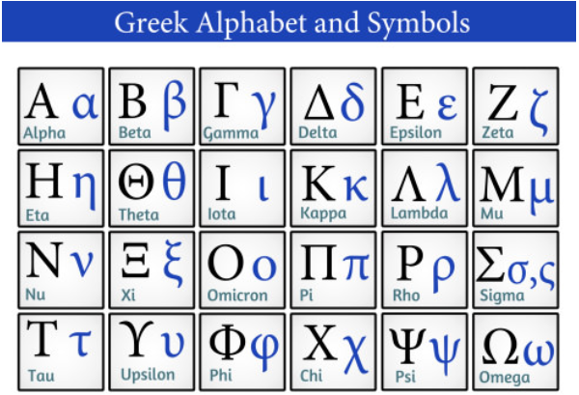
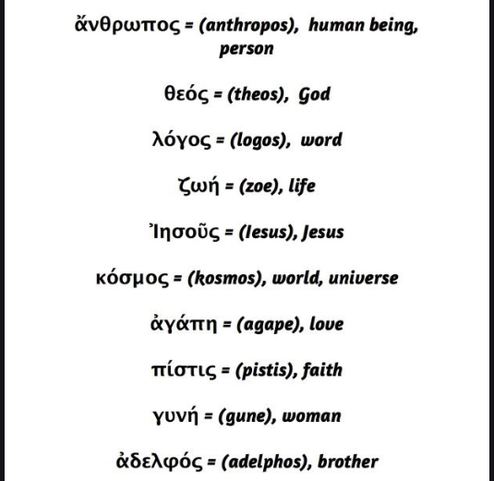
LANGUAGES USED IN THE BIBLE
3. GREEK

Slide 6
AUTHORS OF THE BIBLE
OLD TESTAMENT
AT LEAST 32 AUTHORS FROM: Moses to Malachi
How Many Books in Old Testament: 39
5 Categories (How many per category?)
  Pentateuch (Law) – 5
  History – 12
  Poetry – 5
  Major Prophets – 5
  Minor Prophets – 12

Slide 7
AUTHORS OF THE BIBLE
NEW TESTAMENT
8 AUTHORS: Name them?
How Many Books in New Testament: 27
3 Categories
  Gospels/Acts – 5
  Epistles (Romans to Jude) – 21
  Prophecy (Revelation) – 1
1. Matthew
2. Mark
3. Luke
4. John
5. Paul
6. James
7. Peter
8. Jude

Slide 8
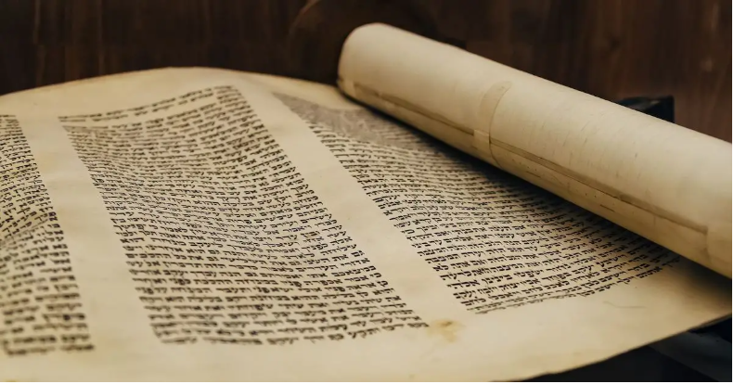
WHEN THE BIBLE WAS WRITTEN
OLD TESTAMENT
Took approximately 1100 years to complete from around 1500 B.C. to 400 B.C.

Slide 9
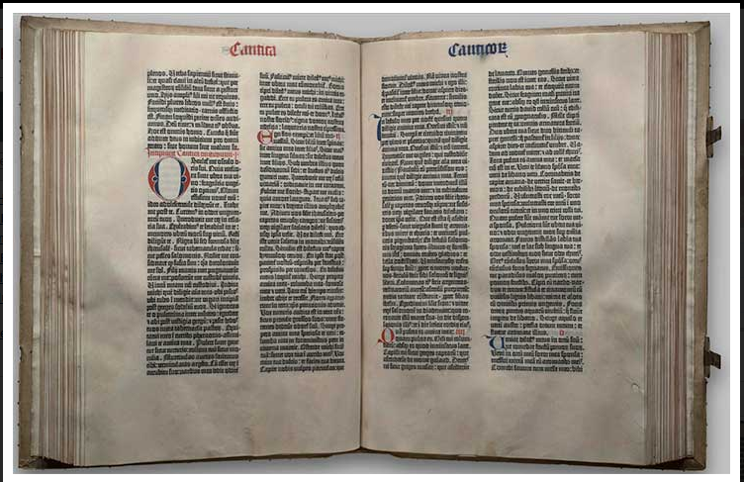
WHEN THE BIBLE WAS WRITTEN
NEW TESTAMENT
Took approximately 50 years to complete

Slide 10
THE SUBJECT OF THE BIBLE
OLD TESTAMENT
1. GOD
2. SATAN
3. MAN
4. GOD
FELL (Gen. 3:1-6)
PROMISED TO SAVE (Gen. 3:15)
DAMAGED (Ezek. 28:15-18; Isa. 14:13-14)
CREATED (Gen. 1:1,26)
What is the correct way to join the person to the action?

Slide 11
THE SUBJECT OF THE BIBLE
NEW TESTAMENT
CHRIST COMING TO:
  REDEEM SINNERS – John 1:29
  BUILD UP THE CHURCH ACCORDING TO GOD’S PLAN – Matt. 16:18

Slide 12
THE CENTRAL THOUGHT
OF THE BIBLE
CHRIST AND THE CHURCH!
EPH. 5:32
This mystery is great, but I speak with regard to Christ and the church.

